Slide 1
SDDP Overview
Simple Device Discovery Protocol

Slide 2

SDDP
Simple Device Discovery Protocol
Allows simple device pairing to a Control4 automation system

Slide 3
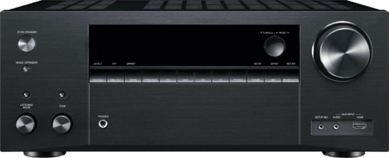
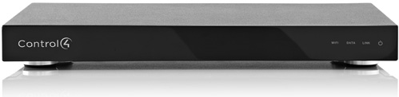
SDDP – Simple Device Discovery
How is a device added to an automation system?
?
Control4 Controller
Custom installation dealers require an easier and more reliable process
A more automated approach is mandatory to broad adoption of automation solutions

Slide 4
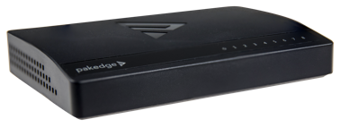
SDDP – Simple Device Discovery
Conceptually similar to UPnP Service Discovery (SSDP)
Ethernet Switch
Control4 Controller
Four Key Benefits of SDDP:
Automatic device discovery
Device pairing with the Control4 system using a unique identifier
Allow devices to use DHCP IP addressing
Automatic driver installation

Slide 5
SDDP – Simple Device Discovery
Alive message contains device information
Control4 Controller
Device Broadcast Alive
Unique ID and current address
Device make/model
Control4 driver

Slide 6
SDDP – Simple Device Discovery
If devices are paired, controller responds
Control4 Controller
Controller Responds
if Identified

Slide 7
SDDP – Simple Device Discovery
Protocol Communication after SDDP exchange
Control4 Controller
Commands and
Responses

Slide 8
SDDP Functional Overview
Simple Device Discovery Protocol

Slide 9
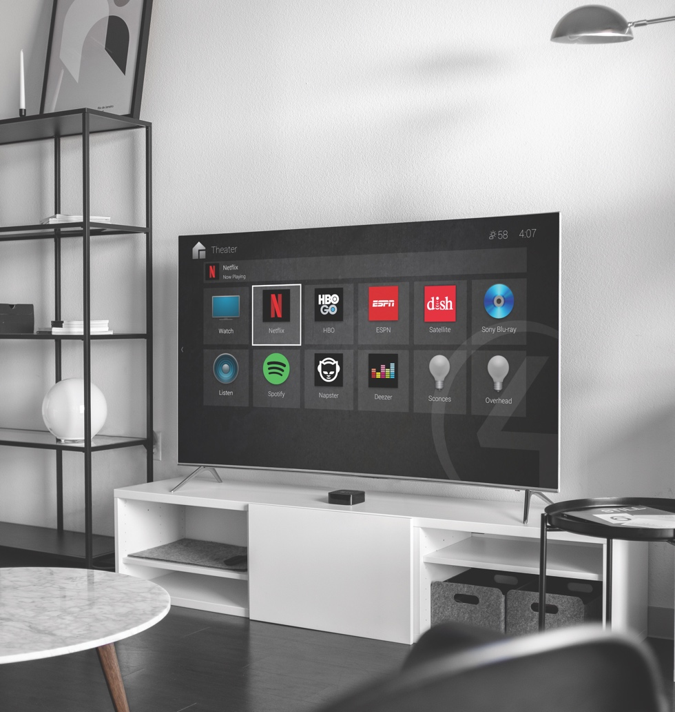
Overview
SDDP leverages existing standards and can work on almost any physical layer
Initial implementation is based on TCP/IP
SDDP provides four distinct benefits:
Enables a Control4 system to identify devices residing on the local area network
Device identification with a unique identifier
Automatic driver installation
Allow devices to be uniquely identified
Allow devices to use DHCP IP addressing
Results in a robust pairing that can withstand network and IP address range changes

Slide 10
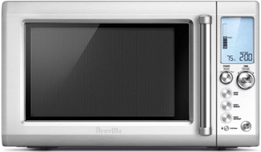
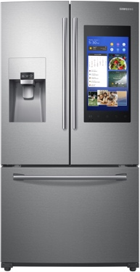
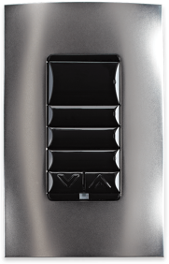
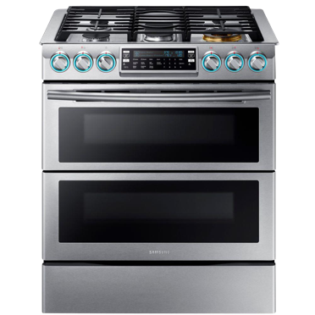
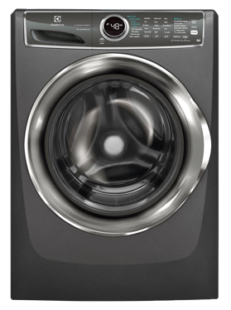
Device Discovery
Automatically finds all devices that can be controlled on the network
Control4 Controller

Slide 11
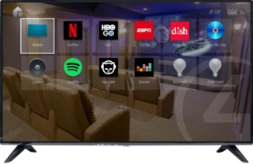
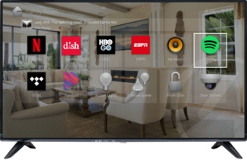
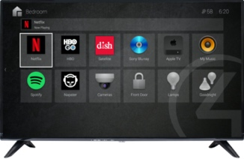
Device Identification
Ability to identify a specific device in the system
Example:
Imagine a home that has three TVs of the exact same model all connected to the local area network. With SDDP the control system would know about all of them but have no way to know which one was in the great room, which one was in the bedroom, and which one was in the den
Device Identification solves this problem by enabling the installer to press a hard or soft button on the device (or its mobile app) to identify specifically which one is being installed
Den
Great Room
Bedroom
Control4 Controller

Slide 12
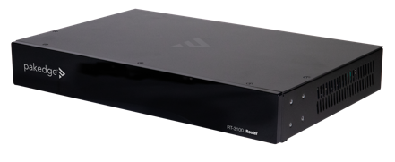
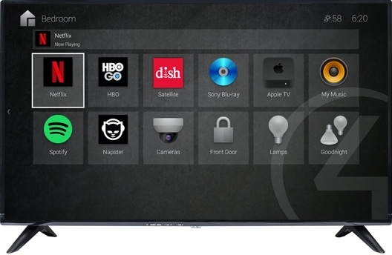
Automatic Driver Installation
This feature allows the device to specify the driver that should be used for the device.
Driver X Request
Cloud Storage
Device Drivers
Driver X Receipt
Driver X Receipt
Driver X Install
I am X device
Control4 Controller

Slide 13
Which Devices Should Use SDDP?
All devices that have the ability to communicate
All devices that have an Ethernet port
All devices that have a WiFi Radio
All devices that could benefit from integration
AV Gear
Appliances
Electrical System Devices (Light Switches and Dimmers, etc.)
Security Equipment (Locks, Cameras, Security Systems, etc.)
Mobile Devices (Phones, Media Players, Game Devices, etc.)
Environmental Systems (Thermostats, Air Conditioners, Humidity Controllers)

Slide 14
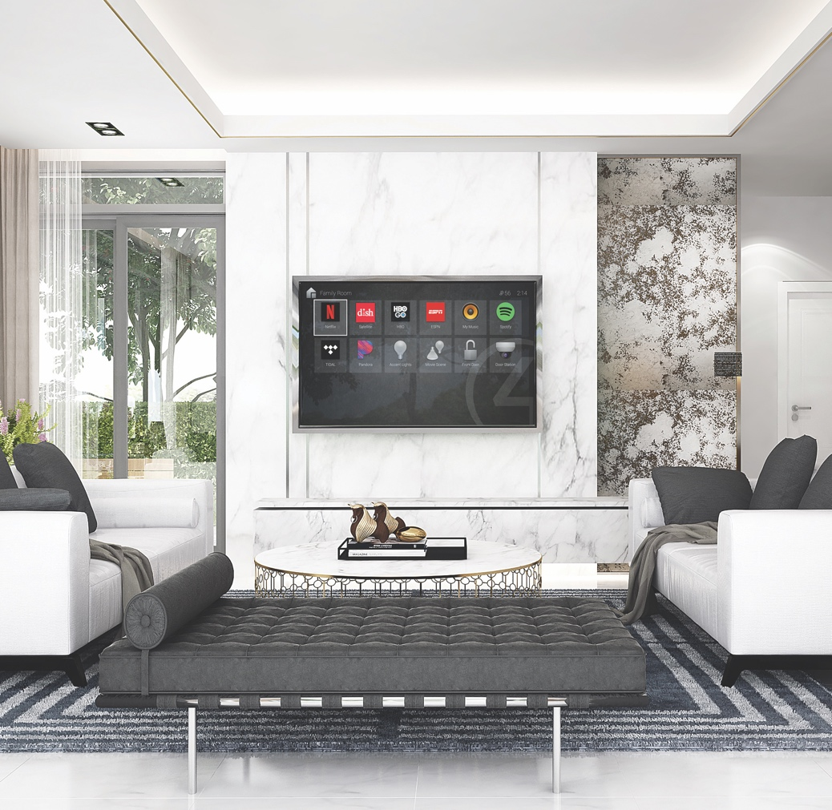
Technical Requirements
Very Small (~100k)
Most common implementation is a small Linux Daemon
At boot the device forms a simple information packet that contains all the key information for the device
When the device starts and stops that information packet is sent as a multicast packet on a well-known port
At startup the device opens a Multicast listener on a well-known port and answers all applicable requests with the same information packet as above
The device also sends the same information packet when the device is “identified”

